Slide 1
Measuring Networks Connectivity
MA 653: Network Science
Instructor: Ashok Singh Sairam
ashok@iitg.ac.in

Slide 2
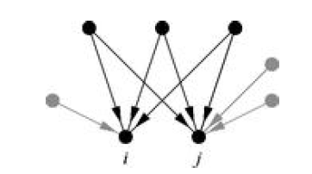
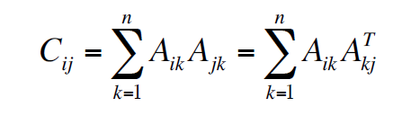

Co-citation coupling
The co-citation of two vertices i and j in a directed network is the number of nodes that have outgoing edges pointing to both nodes i and j
So in order for node k to contribute to the co-citation of i and j, the following needs to be true: A_{ik}A_{jk}=1
Hence the co-citation of nodes i and j is:
The n x n adjacency matrix of the corresponding co-citation network is:

Slide 3
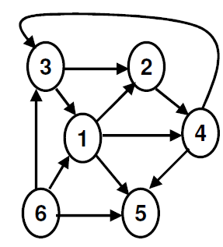
Example: Co-citation coupling

Slide 4
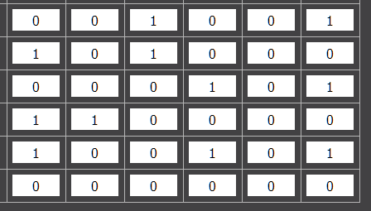
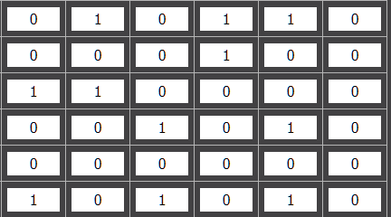
A =
A^{T} =
C = AA^{T}
 | 1 | 2 | 3 | 4 | 5 | 6
1 | 2 | 1 | 1 | 0 | 1 | 0
2 | 1 | 2 | 0 | 1 | 1 | 0
3 | 1 | 0 | 2 | 0 | 2 | 0
4 | 0 | 1 | 0 | 2 | 1 | 0
5 | 1 | 1 | 2 | 1 | 3 | 0
6 | 0 | 0 | 0 | 0 | 0 | 0

Slide 5
A =
A^{T} =
C = AA^{T}
 | 1 | 2 | 3 | 4 | 5 | 6
1 | 2 | 1 | 1 | 0 | 1 | 0
2 | 1 | 2 | 0 | 1 | 1 | 0
3 | 1 | 0 | 2 | 0 | 2 | 0
4 | 0 | 1 | 0 | 2 | 1 | 0
5 | 1 | 1 | 2 | 1 | 3 | 0
6 | 0 | 0 | 0 | 0 | 0 | 0

Slide 6
Co-citation network
A co-citation network (C = AA^{T}) consists of undirected edges
There is an edge between i and j if C_{ij} > 0, for i≠ j,
C_{ii} provides the number of nodes that point to node i
In constructing the co-citation network set all the diagonal elements to zero!
Strength: Cocitation counts of papers increase with time.
The rate of increase can be used to trace the evolution of an academic field.
The co-citation measure reflects the opinion of many authors.
Weakness: Two papers are adjudged “strongly related” if they have more incoming edges to both of them
May not be true if the papers (at least one) have few citations

Slide 7
Problem 1
Consider certain papers and the references that they cite
1 →{2,4,5}
2 → {3,4,5}
3 →{4}
4 →{}
Which of these papers do you expect to be likely of similar topic?

Slide 8
Problem 2
Consider a product website that maintains a purchase profile of the users over a time period T. A snap shot of the same for 4 users are as follows:
A → {1,2,3}
B → {1,3}
C → {1,2, 3, 4}
D →{ 3,4}
If A purchases an unknown product (say 5), can you say which other user will most likely purchase the same product?

Slide 9
Measuring networks: Properties
Two key features of the network’s topology are: connectivity and centrality
Connectivity refers to how actors in one part of the network are connected to actors in another part of the network.
Reachability: Is it possible for actor i to reach actor j? This can only be true if there is a chain of contact from one actor to another.
Distance: Given they can be reached, how many steps are they from each other?
Redundancy: How many different paths connect each pair?

Slide 10
Network features to properties
These features combine in important ways to define characteristic features of networks :
Degree x Reachability
→ Emergent Connectivity
Distance x (Local) Redundancy
→ Small Worlds
Reachability x redundancy
→ Network Resilience

Slide 11
Degree
The degree k_{i} of a vertex i in a graph is the number of edges connected to it
For undirected graphs we have:
And the number of edges of a graph is given by:
Mean degree c of a vertex in an undirected graph is:

Slide 12
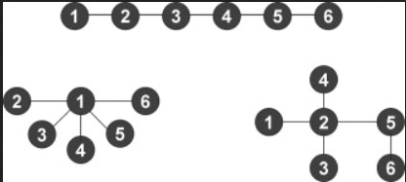

Connectance
Connectance or density ρ of a graph is the fraction of the edges that are actually present
That is the ratio of the edges actually present to the maximum edges possible
Can we define connectance in terms of the mean degree (c)?
What is the connectance of these three graphs?
Most of the networks we are interested in are sufficiently large that Eq. (6.24) can be safely approximated as ρ = c/n.
$$ρ=\frac{m}{\left({n \atop 2}\right)}=\frac{c}{n−1}$$

Slide 13
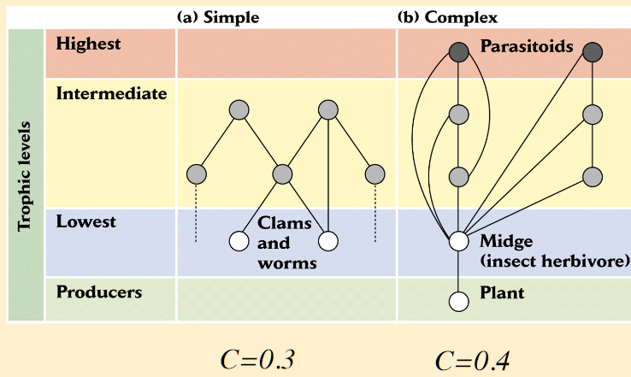

Significance of connectance (1)
Robustness increases with connectance
$ρ=0.3$ $ρ=0.$4
Food web structure

Slide 14
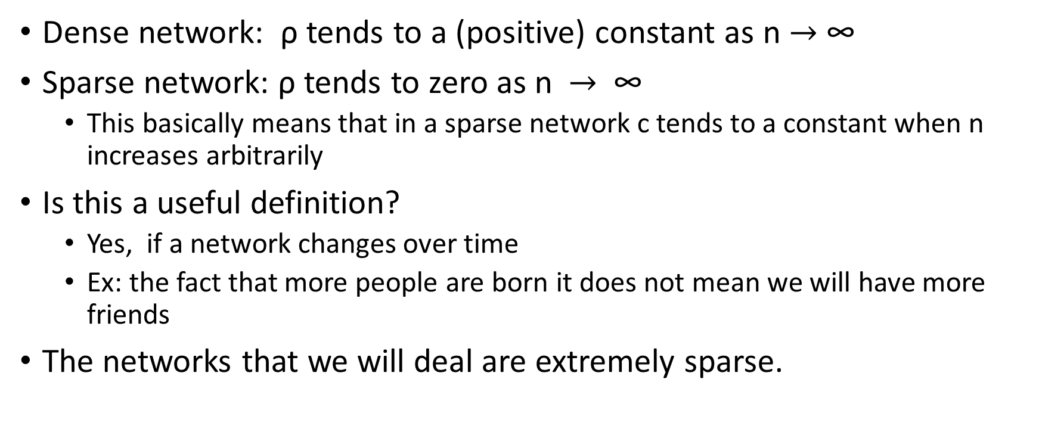
Significance of connectance (2)
Dense network: ρ tends to a (positive) constant as n $→$∞
Sparse network: ρ tends to zero as n $→$ ∞
This basically means that in a sparse network c tends to a constant when n increases arbitrarily
Is this a useful definition?
Yes, if a network changes over time
Ex: the fact that more people are born it does not mean we will have more friends
The networks that we will deal are extremely sparse.

Slide 15
Degrees in directed networks
In a directed network each vertex is associated with two degrees
In-degree is the number of incoming edges to a vertex:
Out-degree is the number of outgoing edges from a vertex:
The total number of edges in a directed network is:
Thus, mean in (c_{in}) and out (c_{out}) degrees are equal

Slide 16
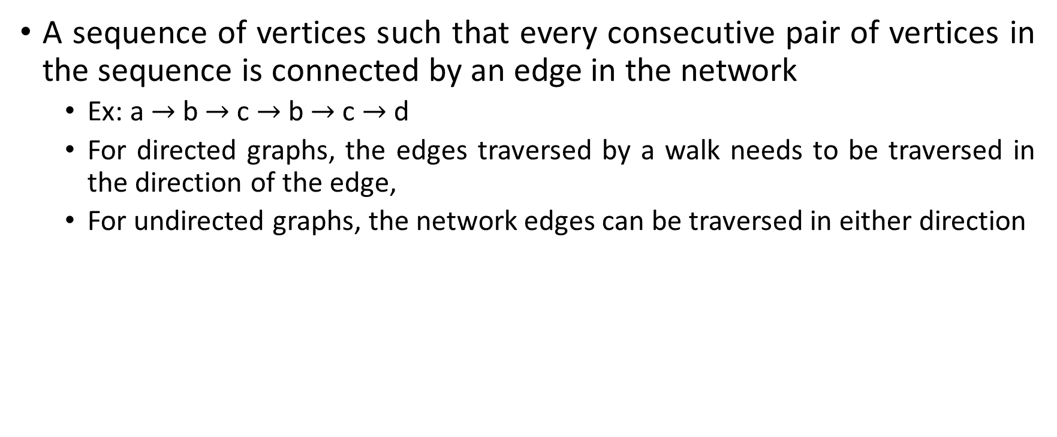
Walk
A sequence of vertices such that every consecutive pair of vertices in the sequence is connected by an edge in the network
Ex: a $→$ b $→$c $→$ b $→$c $→$d
For directed graphs, the edges traversed by a walk needs to be traversed in the direction of the edge,
For undirected graphs, the network edges can be traversed in either direction
b
d
a
b
f
a
c
e
c
f
d
e

Slide 17
Path
Walks that do not intersect with themselves are called self-avoiding paths
Ex: a → b → c→d
Indirect connections are what make networks systems. One actor can reach another if there is a path in the graph connecting them.
Paths can be directed or undirected, leading to a distinction between strong and weak components
Length of a walk is the number of edges traversed along the walk
When a walk traverses the same edge e two times, it is counted twice

Slide 18
Calculating number of Walks
The product A_{ik}A_{kj} is 1 iff there is a path between i and j through k (a path of length 2)
Hence, if we want to find how many length 2 paths between i and j exist:
This can easily be generalized to:
[A^{r}]_{ii} gives the number of length r paths that originate and end at node i (cycles)
Hence if we want to find the number L_{r} of length r cycles in a graph

Slide 19
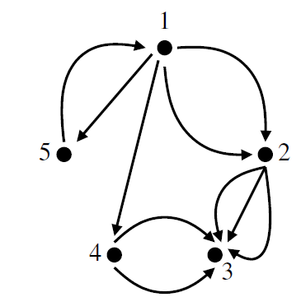
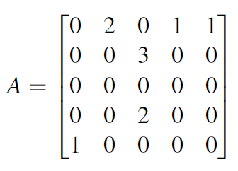
Ex: Calculating number of Walks
How many walks of length 2 between node 1 and 3?

Slide 20
Shortest paths
A geodesic path (shortest path) is a path between two vertices such that no shorter path exists
The length of this path is called the geodesic (or shortest) distance
If two nodes are not connected with any path their geodesic distance is infinite
By definition shortest paths are self-avoiding (why?) => If a path intersects itself then it contains a loop and can be shortened by removing that loop while still connecting the same start and end points, and hence self-intersecting paths are never geodesic paths
Diameter of a network is the length of the longest geodesic path between any pair of vertices in the network for which a path actually exists
Other definitions are extensively used in the literature as well, such as, the average value of all geodesic paths in the network etc.

Slide 21
Computing shortest path
Using powers of the adjacency matrix
The shortest path between nodes i and j is the smallest value of r such that [A^{r}]_{ij}>0
Shortest plays an important role. The small world effect is a statement about shortest paths
However, computing the shortest path using adjacency matrix multiplication is not the best approach
Calculating distance in global networks: Breadth-First Search
More on shortest path later!

Slide 22
Eulerian and Hamiltonian paths
An Eulerian path is a path that traverses each edge in a network exactly once
A Hamiltonian path is a path that visits each vertex exactly once
Self avoiding
Konisberg Bridge Problem

Slide 23
Trees
Connected, undirected network with no closed loops
Since there are no closed loops there is exactly one path from every vertex to any other
This property is important because it makes some calculations particularly simple
A tree with n vertices has exactly n-1 edges
Reverse is also true!

Slide 24
Component
A network for which there exists pairs of vertices that there is no path between them is called disconnected
If there exists a path between any possible
pair of vertices in a network the latter is
called connected
If there is at least one path connecting every pair of actors in the graph, the graph is connected and is called a component.
Component is a maximal subset of vertices of a network such that there exists at least one path from every vertex of the subgroup to any other
Adjacency matrix of a network with more than one component?

Slide 25
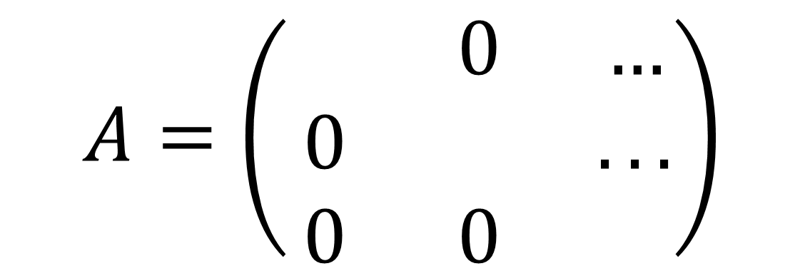
Adjacency matrix of components
Adjacency matrix of a network with more than one component can be written in block diagram form
The non-zero elements are confined to square blocks along the diagonal
Requires the labels to be chosen appropriately
$$A=\left(\begin{matrix} & 0 & … \\ 0 & & ... \\ 0 & 0 & \end{matrix}\right)$$

Slide 26
Components in directed networks
There are many different types of connected components that we can define for a directed network
Assuming no direction on the edges, we can identify connected components as in an undirected graph
Weakly connected components
Imposing a constrained on the direction of the edge we get the strongly connected components
Maximal subsets of vertices such that there is a directed path in both directions between every pair in the subset
Every vertex belonging to a strongly connected component with more than one vertex must belong to at least one cycle (why?) => Indeed every vertex in such a component must belong to at least one cycle, since there is by definition a directed path from that vertex to every other in the component and a directed path back again, and the two paths together constitute a cycle

Slide 27
Ex: Components in directed networks
What is the number of weakly and strongly connected components?
Ans => 2 weakly (ABCD, EFGH), 5 strongly (ABC, D, EF, G, H)
A
E
H
C
D
F
G
B

Slide 28
Out-components and In-components (1)
The set of vertices that are reachable via directed paths from node A (including A), form its out-component
Out-component is a property of both the network and the starting vertex
Hence, a vertex can belong to more than one out-components
The in-component of a specific vertex A is the set of all vertices (including A) from which there is a directed path to A
Strongly connected components of vertex A is the intersection of its out and in components

Slide 29
Out-components and In-components (2)
All members of the strongly connected component that A belongs to, are members of its out-component
All vertices that are reachable from A are also reachable from any other member of its strongly connected component
Out-components really “belong” not to individual vertices but to strongly connected components
All the members of a strongly connected component have the same in-component (as well as same out-component)
A’s strongly connected component is the intersection of its out- and in-components

Slide 30
Ex: In and Out components
E
In component of vertex A: (A, B, C, G)
Out component of vertex A: (A, B, C, D, F)
Strongly connected components of A: (A, B, C)
D
F
B
A
C
G
H

